Slide 1

BMS College of Engineering
Department of Information Science and Engineering
“Autocompletion and spell checker using dynamic programming”
By :-
ADITYA A KAMAT (1BM18IS003)
ARYAN (1BM18IS018)

Slide 2
Abstract
Autocomplete is a feature in which an application predicts the rest of a word a user is typing. Many autocomplete algorithms learn new words after the user has written them a few times, and can suggest alternatives based on the learned habits of the individual user.
a spell checker (or spelling checker or spell check) is a software feature that checks for misspellings in a text. Spell-checking features are often embedded in software or services, such as a word processor, email client, electronic dictionary, or search engine.

Slide 3
Introduction
The levenshtein distance algorithm is a dynamic programming algorithm which is a text similarity measure that compares two words and returns a numeric value representing the distance between them.
The more similar the two words are, the less the distance between them, and vice versa.

Slide 4
Problem Statement
Implement Autocomplete and Spell checking using Levenshtein Distance algorithm

Slide 5
Relevance
Autocompletion is one of the most important concept applied in smartphone keyboards and is also used in softwares such as Microsoft Word and Google Slides.
Spell Checker is the core application of softwares such as Grammarly, which performs spell checking while writing emails or drafting reports.

Slide 6
Literature Survey
SL.NO | Title of the Paper | Problem Addressed | Authors Approach / Method | Results
1 | Autocomplete and Spell Checking Levenshtein Distance Algorithm to Getting Text Suggest Error Data Searching in Library | To apply the autocomplete feature and spell checking with Levenshtein distance algorithm to get text suggestion in an error data searching in library and determine the level of accuracy on data search trials. | The feature that was used to provide autocomplete and spell checking was the Levenshtein distance algorithm. | Spell checking accuracy rate obtained from the system as 86%.
2 | Research on String Similarity Algorithm based on Levenshtein Distance | Similarity algorithm based on Levenshtein Distance is improved. | Longest Common Subsequence (LCS) and Longest Continuous Common Substring (LCCS) are used. | The calculation of string similarity is further improved taking into account the important influence of LCS and LCCS on the computation of string similarity.

Slide 7
Literature Survey
SL.NO | Title of the Paper | Problem Addressed | Authors Approach / Method | Results
3 | Levenshtein Distance Algorithm for Efficient and Effective XML Duplicate Detection | The aim of this project is to present a novel algorithm to find duplicate objects in the hierarchical structures, like XML files. | Proposed system uses Levenshtein distance algorithm to find duplicates in structured data. | Using Levenshtein Distance algorithm gives better result than Normalized Edit Distance algorithm.
4 | Levenshtein Distance Algorithm Analysis on Enrollment and Disposition of Letters Application | This project results in the form of a letter filing and disposition application by applying the Levenshtein distance algorithm in letter search to speed up the letter search process. | To make it easier to letter archiving and speed up searching for letters, the Levenshtein distance algorithm is used. | Archiving design and letter disposition can display data by the word being searched even though there are some errors when writing the word you want to search for.

Slide 8
Literature Survey
SL.NO | Title of the Paper | Problem Addressed | Authors Approach / Method | Results
5 | Using the Levenshtein Edit Distance for Automatic Lemmatization: A Case Study for Modern Greek and English | Performing an accurate lemmatization can be a quite difficult and time-consuming task especially for morphologically complex languages with highly inflexional structure, such as the Modern Greek language. | The Levenshtein Distance is implemented on a dictionary-based algorithm in order to achieve the automatic induction of the normalized form (lemma) of regular and mildly irregular words with no direct supervision. | In this paper, a new language independent lemmatization algorithm based on the Levenshtein distance was demonstrated and its performance was evaluated both on Modern Greek and English languages.
6 | Levenshtein Distance, Sequence Comparison and Biological Database Search | The advent of modern genomic sequencing and the volume of data it generates has resulted in a return to the problem of local alignment. | Given two biological sequences of length n, the basic problem of biological sequence comparison can be recast as that of determining the Levenshtein distance between them. | Although some modern bioinformatics heuristics using k-mer matching have partially supplanted the direct optimization of Levenshtein distance, the algorithm is still relevant.

Slide 9
Literature Survey
SL.NO | Title of the Paper | Problem Addressed | Authors Approach / Method | Results
7 | Learning String-Edit Distance | Determination of similarity of two strings | The authors implement a string-edit distance that reduces the error rate of the untrained Levenshtein distance by a factor of 4.7, to within 4 percent of the minimum error rate achievable by any classifier. | The authors demonstrate the efficacy of their techniques by correctly recognizing over 87 percent of the unseen pronunciations of syntactic words in conversational speech, which is within 4 percent of the maximum success rate achievable by any classifier.
8 | Kernels Based on Weighted Levenshtein Distance | To determine the similarity or dissimilarity of two strings in many training algorithms. | The authors replace distance measure in the RBF and exponential kernels and inner product in polynomial and form a new class of string kernels: Levenshtein kernels. | It is demonstrated that incorporating prior knowledge about problems at hand into kemels can improve the performance of kemel machines effectively.

Slide 10
Literature Survey
SL.NO | Title of the Paper | Problem Addressed | Authors Approach / Method | Results
9 | Computing the Levenshtein Distance of a Regular Language | In this paper, the problem of computing the edit distance of a regular language is considered. | The authors distinguish two cases depending on whether the given automaton is deterministic or nondeterministic. | The authors show why the problem of computing the edit distance of a given regular language is of polynomial time complexity.
10 | Plagiarism Detection Using the Levenshtein Distance and Smith-Waterman Algorithm | Demonstrating the practicality of the Levenshtein algorithm for plagiarism detection. | Using the Levenshtein Distance algorithm and Smith-Waterman Algorithm. | The authors have described how the Levenshtein distance can be used to change the likely scarcity, which can improve both time and space efficiency.

Slide 11
Literature Survey
SL.NO | Title of the Paper | Problem Addressed | Authors Approach / Method | Results
11 | A Normalized Levenshtein Distance Metric | To improve the metric between two strings and satisfy the triangle inequality. | The Generalised Levenshtein Distance algorithm is used. | The main contribution of the paper is to prove that the new distance is a metric valued in [0, 1] and can generally achieve similar accuracies to two other normalized edit distances.
12 | String correction using the Damerau-Levenshtein distance | In this paper, the authors focus on the development of algorithms whose space complexity is less and whose actual runtime and energy consumption are less than those of the algorithm of Lowrance and Wagner. | The authors develop space- and cache-efficient algorithms to compute the Damerau-Levenshtein (DL) distance between two strings. | The authors’ algorithms are able to handle much larger sequences than earlier algorithms due to the reduction in space requirements.

Slide 12
Literature Survey
SL.NO | Title of the Paper | Problem Addressed | Authors Approach / Method | Results
13 | Adapting the Levenshtein Distance to Contextual Spelling Correction | To screen and refine the results obtained by Levenshtein Distance and apply to errors in Arabic words. | The authors developed a system for correcting spelling errors in the Arabic language based on language models and Levenshtein algorithm. | From the results obtained, it is clear that this combination helps improve satisfactorily scheduling solutions returned by our method.
14 | A Comparison of Standard Spell Checking Algorithms and a Novel Binary Neural Approach | To create an approach that is aimed towards isolated word error correction. | The authors integrate Hamming Distance and n-gram algorithms that have high recall for typing errors and a phonetic spell-checking algorithm in a single novel architecture. | The proposed hybrid methodology has the highest recall rate of the techniques evaluated. This method has a high recall rate and low-computational cost.

Slide 13
Literature Survey
SL.NO | Title of the Paper | Problem Addressed | Authors Approach / Method | Results
15 | Spelling Checker Algorithm Methods for Many Languages | To implement spell checking in languages such as Arabic, Chinese, Hindi, Japanese etc. | The approach is divided into several parts, which are: determine the sources of research, define the keyword model for the search process, start inclusion and exclusion criteria, extract data and analyze the result to answer a research question. | It is known that every language has a different method of spell checking. The Damerau-Levenshtein algorithm method is most frequently used for spell checkers.

Slide 14
Methodology
We used Levenshtein Distance Algorithm to calculate the similarity between the input word and the target word in both spell check and auto-complete programs.
Here 3 techniques can be used for editing the input word into target word:
-Insertion
-Deletion
-Replacement

Slide 15
Methodology
The algorithm:
Step 1: Initialization
I.Set a is the length of document 1 say d1, set b is length of document 2 say d2.
II.Create a matrix that consists 0 – b rows and 0 – a columns.
III.Initialize the first row from 0 to a.
IV.Initialize the first column from 0 to b.

Slide 16
Methodology
Step2: Processing
I. Observe the value of d2 (i from 1 to a).
II. Observe the value of d1 (j from 1 to b).
III. If the value at d2[i] is equals to value at d1[j], the cost becomes 0.
IV. If the value at d2[i] does not equal d1[j], the cost becomes 1.
V. Set block of matrix M[d1, d2] of the matrix equal to the minimum of:
I. the block immediately above add 1: M [d2–1, d1]
Ii. the block immediately to the left add 1: M [d2, d1–1] +1.
Iii. The block is diagonally above and to the left adds the cost: M [d2–1, d1–1] + cost.
Step 2 is repeated till the distance M[a, b] value is found.

Slide 17
Methodology
Step 3: Result [1, 5].
2.1 Computing Techniques
Dis(i,j) = score of best alignment from d11..d1i to d21…..d2j
Dis (i–1, j–1) + d (d1i, d2j) //copy Dis (i–1, j) + 1 //insert
Dis (i, j–1) + 1 //delete
Cost depend upon following factors:
Dis (0, 0) = 0 cost // if both strings are same
Dis (i, 0) = dis (i–1, 0) +1 = 0 // if source string is empty
Dis (0, j) = dis (0, j–1) +1 = 0 // if target string is empty [6, 7]

Slide 18
Methodology
For example:
● Given two words, hello and hello, the Levenshtein distance is zero because the words are identical.
● For the two words helo and hello, it is obvious that there is a missing character "l". Thus to transform the word helo to hello all we need to do is insert that character. The distance, in this case, is 1 because there is only one edit needed.
● On the other hand, for the two words kelo and hello more than just inserting the character "l" is needed. We also need to substitute the character "k" with "h". After such edits, the word kelo is converted into hello. The distance is therefore 2, because there are two operations applied: substitution and insertion.
● For the two words kel and hello, we must first replace "k" with "h", then add a missing "l" followed by an "o" at the end. As a result, the distance is 3 because there are three operations applied.

Slide 19
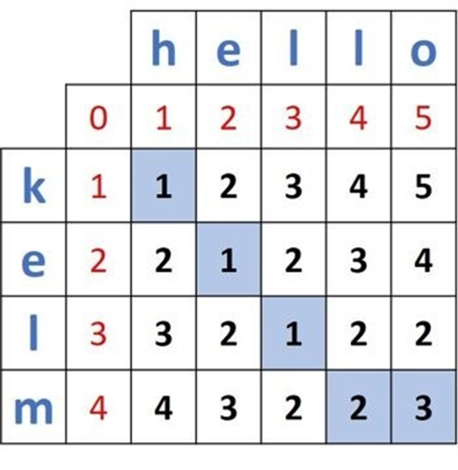
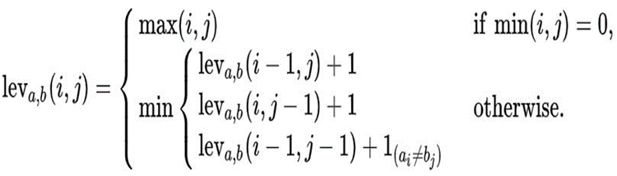
Methodology
Here “hello” is input word that has to be transformed into “kelm” which is target word. By this method we can find the levenshtein distance.

Slide 20
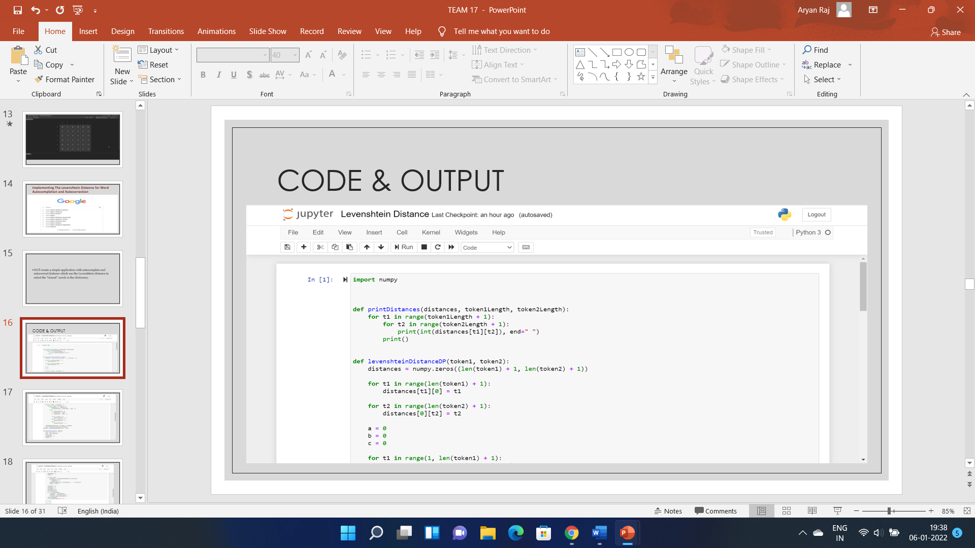
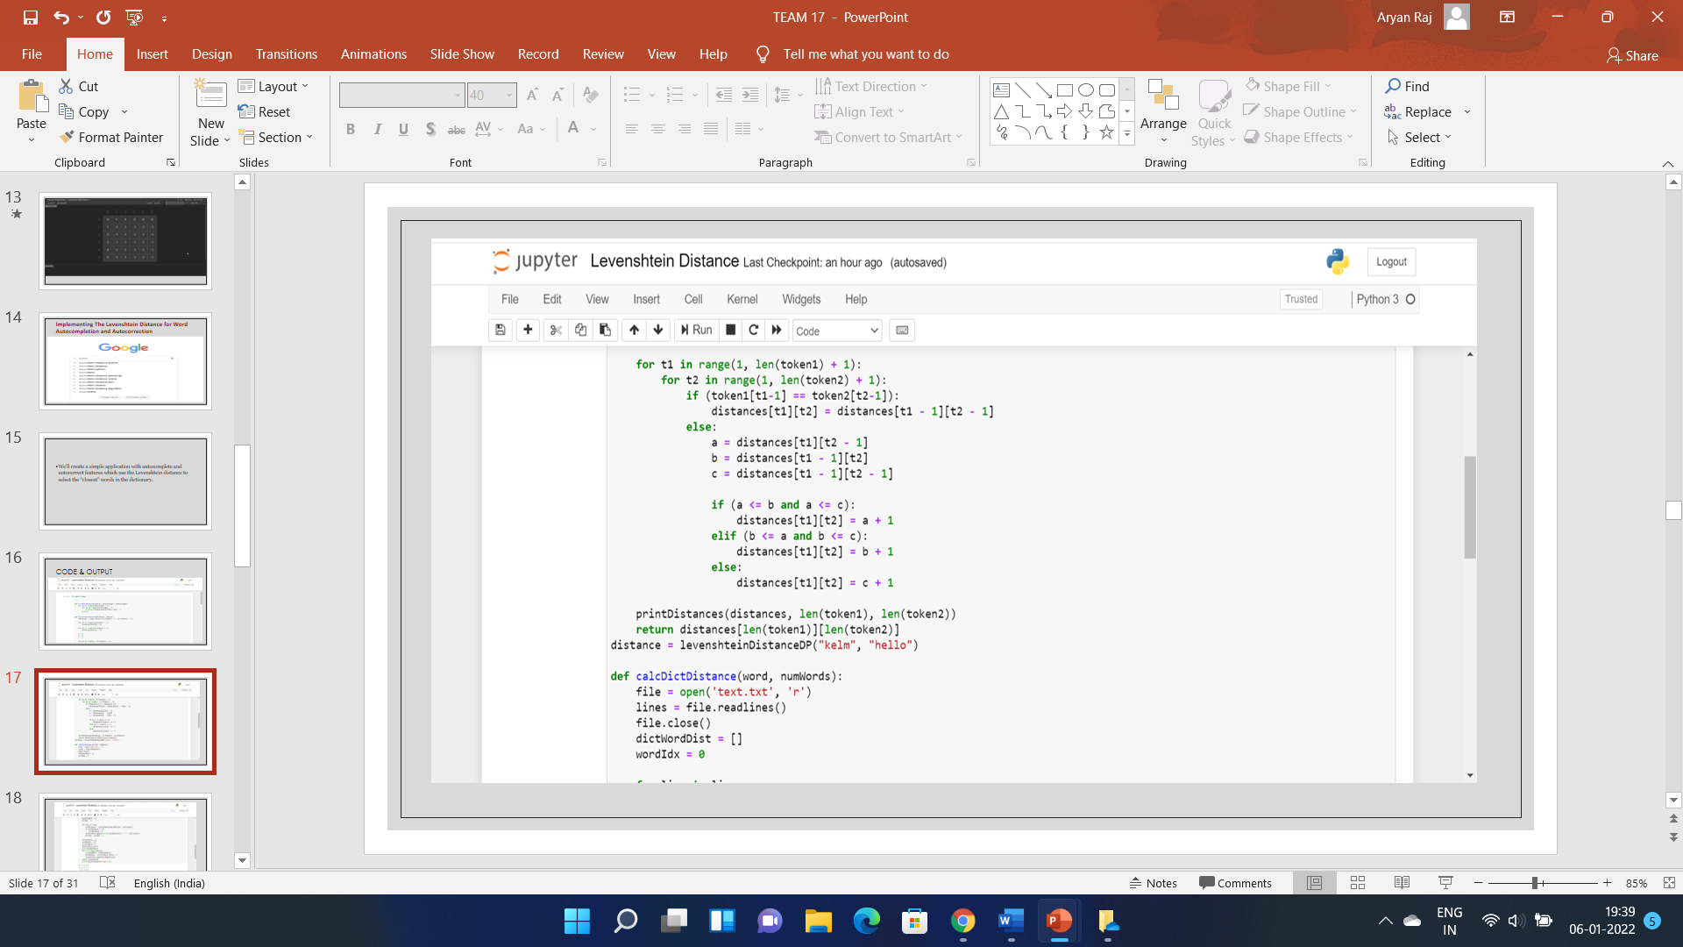
Implementation
Autocomplete using Levenshtein Distance algorithm:

Slide 21
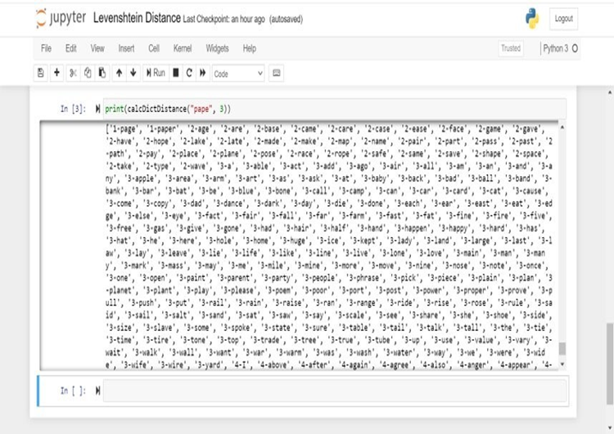
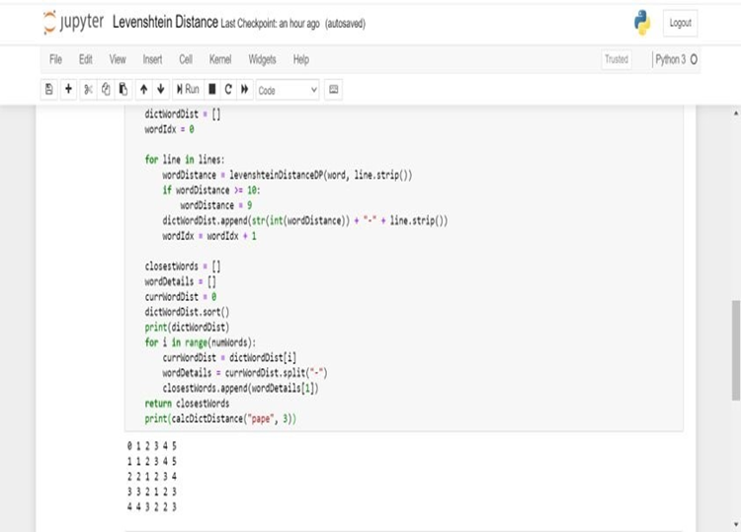
Implementation
Autocomplete using Levenshtein Distance OUTPUT:
algorithm:

Slide 22
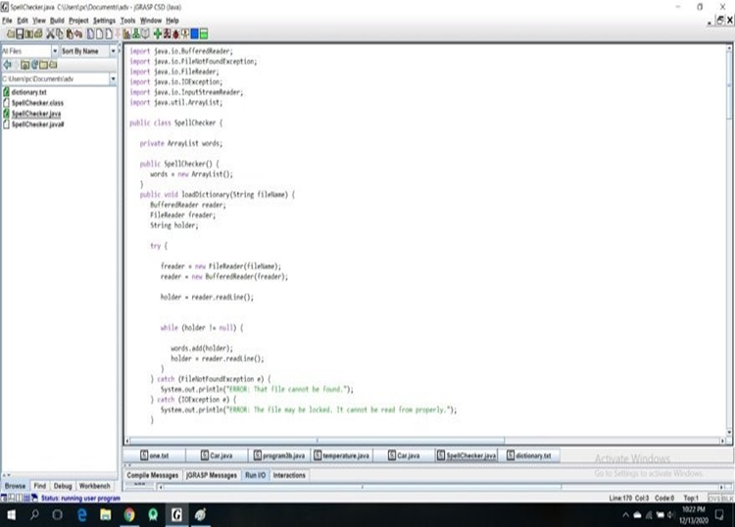
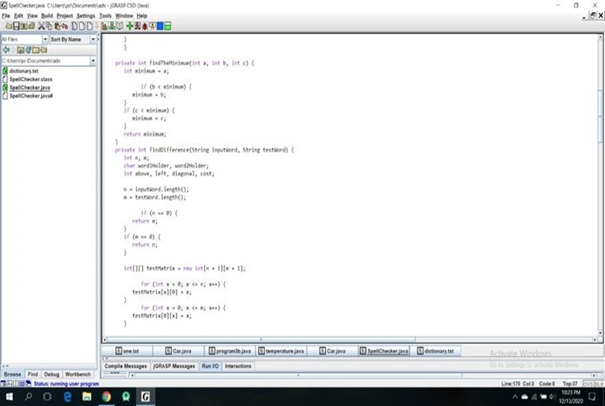
Implementation
Spell check using Levenshtein Distance Algorithm

Slide 23
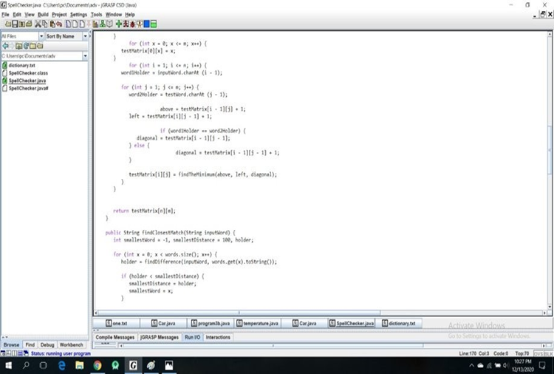
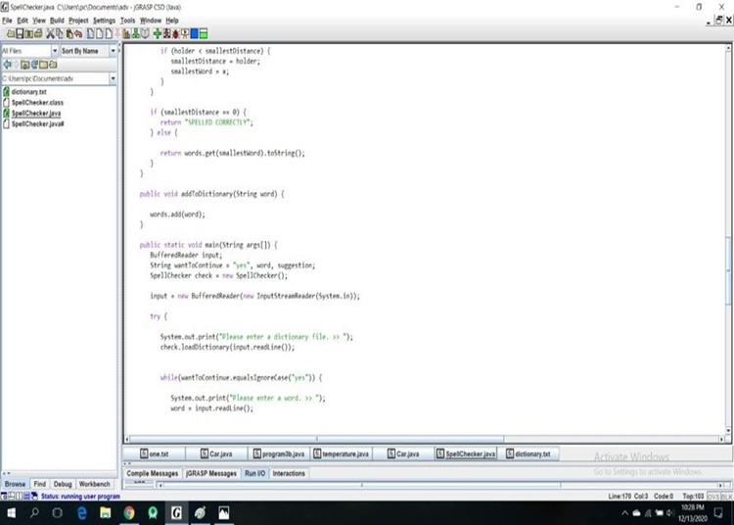
Implementation
Spell check using Levenshtein Distance Algorithm

Slide 24
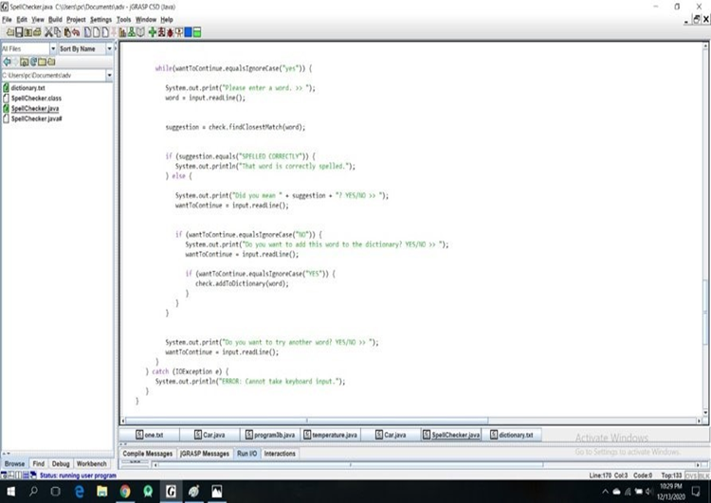
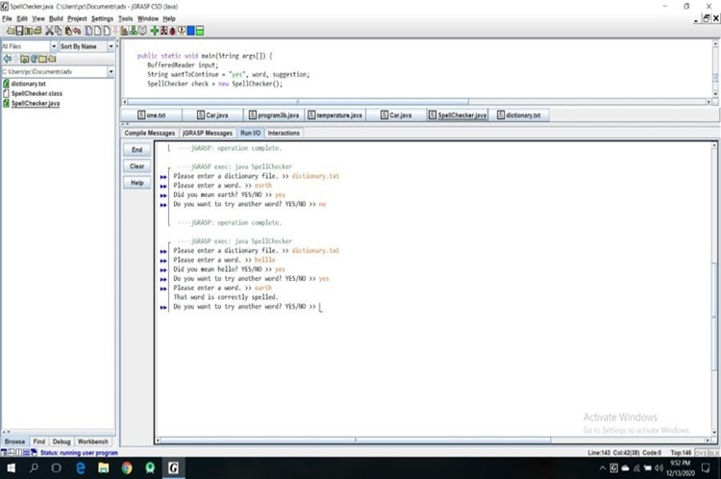
Implementation
Spell check using Levenshtein Distance Algorithm OUTPUT

Slide 25
Conclusion
Here we are solving two problems i.e. spell checking and auto-complete, these both can be solved using Levenshtein Distance Algorithm where we are deciding the similarity of two words based on their levenshtein distance.
With the help of similarity we can auto-complete the words and also check if the word is spelled correctly.

Slide 26
Conclusion
Time analysis:
Best case: O(m*n)
As we are using 2 for loops to fill the edit distance matrix and get the levenshtein distance, O(m*n) where m is the length of the test word and n is length of input word.
Worst case: O(m*n*p)
O(m*n*p) where m is length of target word, n is length of input word, p is the place or index of the target word in the imported dictionary as we have to check the Levenshtein distance of each word to find the match in spell check as well as in autocomplete.

Slide 27
References
Autocomplete and Spell Checking Levenshtein Distance Algorithm to Getting Text Suggest Error Data Searching in Library
Muhammad Maulana Yulianto, Riza Arifudin, Alamsyah
Research on String Similarity Algorithm based on Levenshtein Distance
Shengnan Zhang, Yan Hu, Guangrong Bian
Levenshtein Distance Algorithm for Efficient and Effective XML Duplicate Detection
Mrs.Shital Gaikwad, Prof.Nagaraju Bogiri
Levenshtein Distance Algorithm Analysis on Enrollment and Disposition of Letters Application
Sugiarto, I Gede Susrama Mas Diyasa, Ilvi Nur Diana
Using the Levenshtein Edit Distance for Automatic Lemmatization: A Case Study for Modern Greek and English
Dimitrios P. Lyras, Kyriakos N. Sgarbas, Nikolaos D. Fakotakis
Levenshtein Distance, Sequence Comparison and Biological Database Search
Bonnie Berger, Michael S. Waterman, and Yun William Yu

Slide 28
References
Learning String-Edit Distance
Eric Sven Ristad and Peter N. Yianilos
Kernels Based on Weighted Levenshtein Distance
Jianhua XU and Xuegong ZHANG
Computing the Levenshtein Distance of a Regular Language
Stavros Konstantinidis
Plagiarism Detection Using the Levenshtein Distance and Smith-Waterman Algorithm
Zhan Su, Byung-Ryul Ahn, Ki-yol Eom, Min-koo Kang, Jin-Pyung Kim, Moon-Kyun Kim
A Normalized Levenshtein Distance Metric
Li Yujian and Liu Bo
String correction using the Damerau-Levenshtein distance
Chunchun Zhao and Sartaj Sahni
Adapting the Levenshtein Distance to Contextual Spelling Correction
Si Lhoussain Aouragh, Hicham Gueddah and Abdellah Yousfi
A Comparison of Standard Spell Checking Algorithms and a Novel Binary Neural Approach
Victoria J. Hodge and Jim Austin
Spelling Checker Algorithm Methods for Many Languages
Novan Zukarnain, Agung Trisetyarso, Bahtiar Saleh Abbas, Chul Ho Kang and Suparta Wayan

